Slide 1
DNS Sinkhole
Bo Pan

Slide 2
DNS attacks
DNS amplification (DDoS, flood attack)
DNS hijacking (MITM)
DNS cache poisoning or spoofing
Many more…

Slide 3
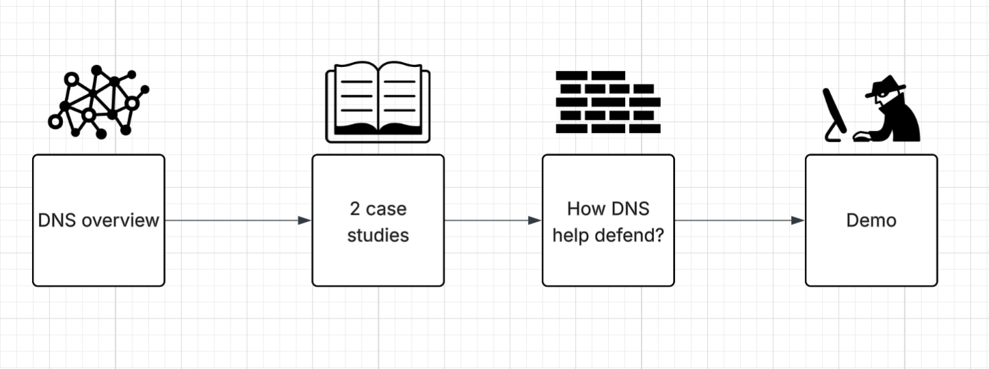
DNS sinkhole for defending
Bonus

Slide 4
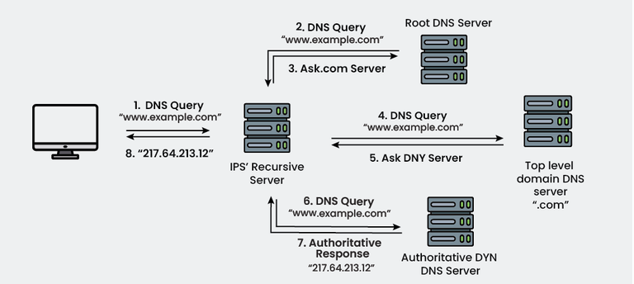
DNS recap
It is important because it tells us where to go (phone book)

Slide 5
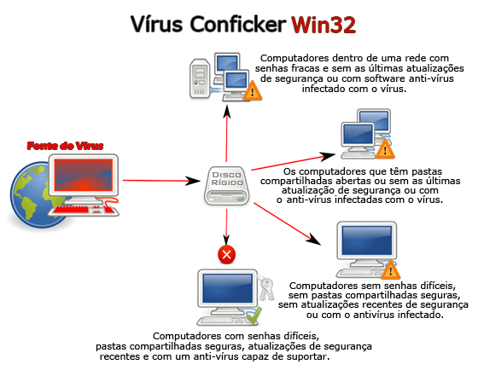

Case study 1 – Microsoft Conficker (MS08-067)
The Worm No One Saw Coming
Infection: Conficker spreads automatically by exploiting the MS08-067 Windows vulnerability, weak admin passwords, and removable media like USB drives—no user action required.
Botnet Integration: Infected machines connect to attacker-controlled servers using a Domain Generation Algorithm (DGA) to receive commands and updates.
Command & Control: The worm can download additional malware or instructions from these domains
Malicious Activities: Conficker primarily propagates itself, scans networks, and maintains control over infected machines; it does not steal money or lock files.
Notes:
In 2008, one day it was fine, but overnight, the worm is all over the place... More than 15M computers are infected. And it was in 2008, not a lot people have computer! So it goes to show how fast and wide it was. So what happended?

Slide 6
Case study 1 – Microsoft Conficker (MS08-067)
The Worm No One Saw Coming
Infection: Conficker spreads automatically by exploiting the MS08-067 Windows vulnerability, weak admin passwords. Slower performance. Block update, Antivirus. Massive DNS lookup
Botnet Integration: Infected machines connect to attacker-controlled servers using a Domain Generation Algorithm (DGA) to receive commands and updates.
Command & Control: The worm can download additional malware or instructions from these domains
Malicious Activities: Conficker primarily propagates itself, scans networks, and maintains control over infected machines; it does not steal money or lock files.

Slide 7
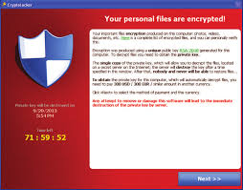
Case study ii – GAMEOVER zeus
Infection: GOZ primarily spreads through phishing emails, malicious attachments, or drive-by downloads.
Botnet Integration: Once a computer is infected, it joins the peer-to-peer (P2P) botnet, communicating with other infected machines instead of a central server.
Command & Control: Instructions, updates, and additional malware are sent through the P2P network or, as a fallback, via DGA-generated domains.
Malicious Activities: GOZ steals banking credentials, initiates unauthorized transfers, and can deliver other malware, such as ransomware.
Resilience: The P2P structure and DGA fallback make GOZ hard to disrupt, allowing it to operate even if some nodes are taken down.

Slide 8
Case study ii – GAMEOVER zeus
Infection: GOZ primarily spreads through phishing emails, malicious attachments, or drive-by downloads.
Botnet Integration: Once a computer is infected, it joins the peer-to-peer (P2P) botnet, communicating with other infected machines instead of a central server.
Command & Control: Instructions, updates, and additional malware are sent through the P2P network or, as a fallback, via DGA-generated domains.
Malicious Activities: GOZ steals banking credentials, initiates unauthorized transfers, and can deliver other malware, such as ransomware.

Slide 9
What do they have in common?
Turns the infected machine into a bot which belongs to a botnet group
Relied on DNS to reach their command-and-control servers (C2)
Notes:
I hope you start seeing a pattern…
What

Slide 10
solution
1. Global Domain Pre-registration (Sinkholing at the source)
Conficker’s DGA generates thousands of domains every day.
Security teams (Conficker Working Group) pre-registered these domains before the malware tried to use them.
This ensures that any infected machine trying to resolve a DGA domain hits a safe sinkhole server instead of the real C2.
2. Local DNS Blocking
Organizations or home users can run a DNS filter
Any request for known malicious domains (from blocklists or observed DGA domains) is intercepted locally and redirected to a safe address or blocked.

Slide 11

SINKHOLE demo
Feel free to ride along!

Slide 12
Steps
Device set up (done)
Set dns ip to xxx.xxx.xxx.xxx
Open up zhiju.me
Open incognito window (to avoid browser history)
Open terminal – nslookup zhiju.me
Notice the ip addr returned from pi-hole
Bonus!

Slide 13
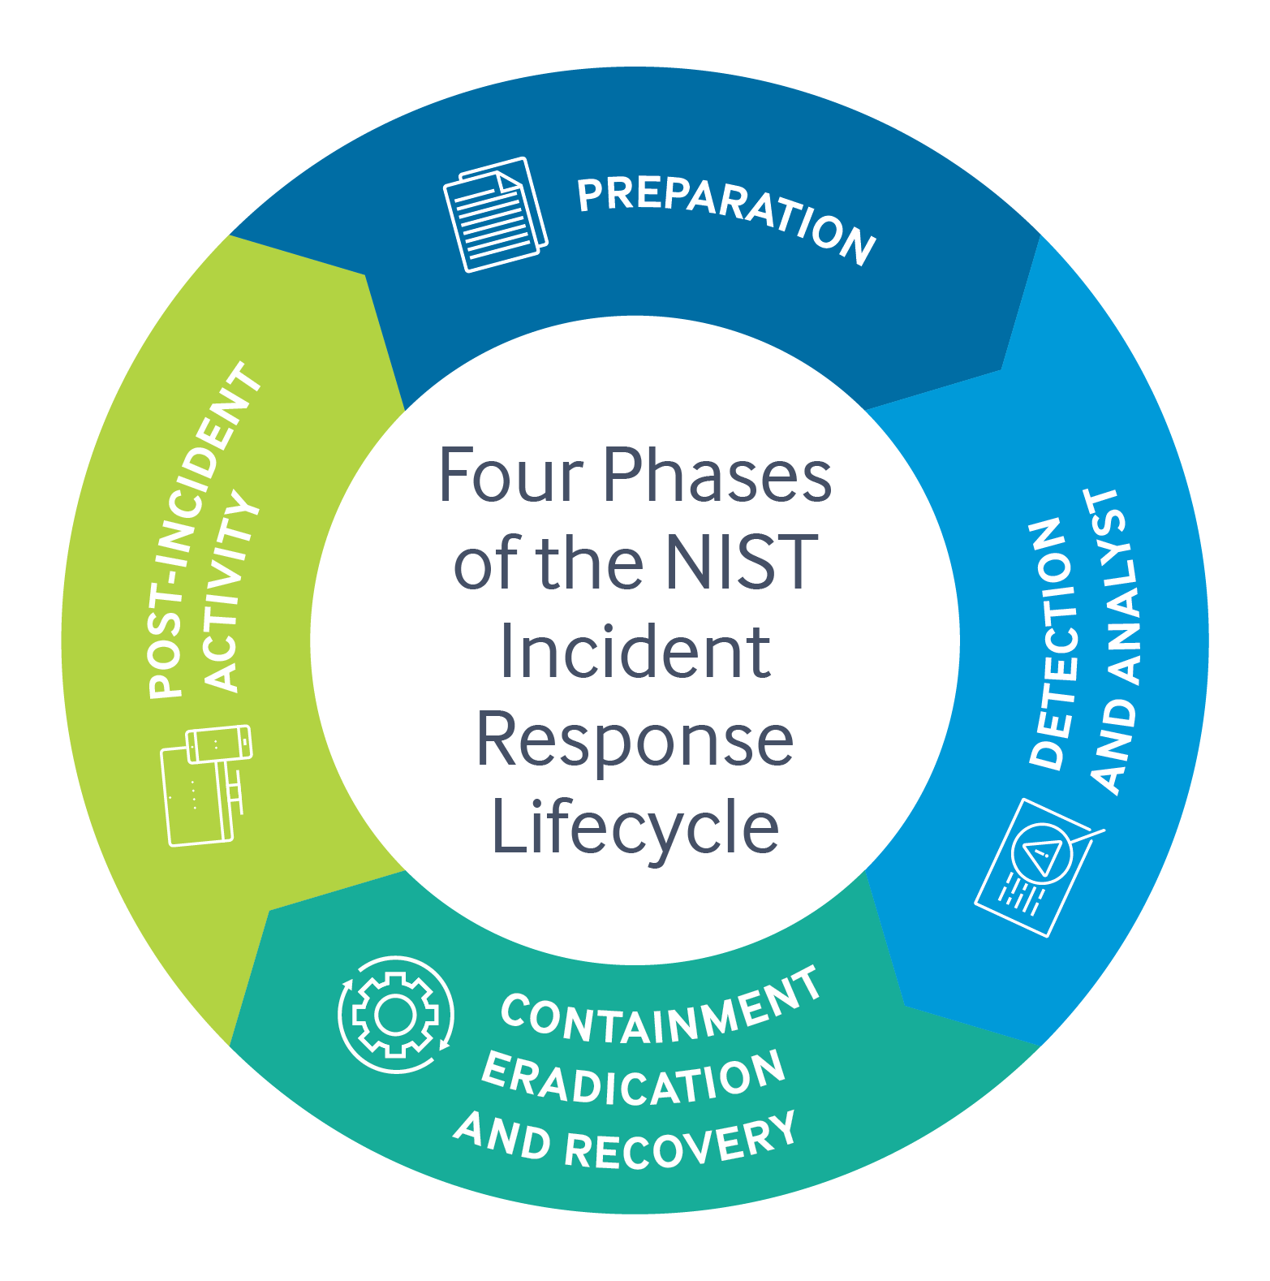
Limitation
Does not resolve the attack directly

Slide 14
WRAP-UP
How dns works
2 case study
Live demo
AD blocking
Limitation

Slide 15
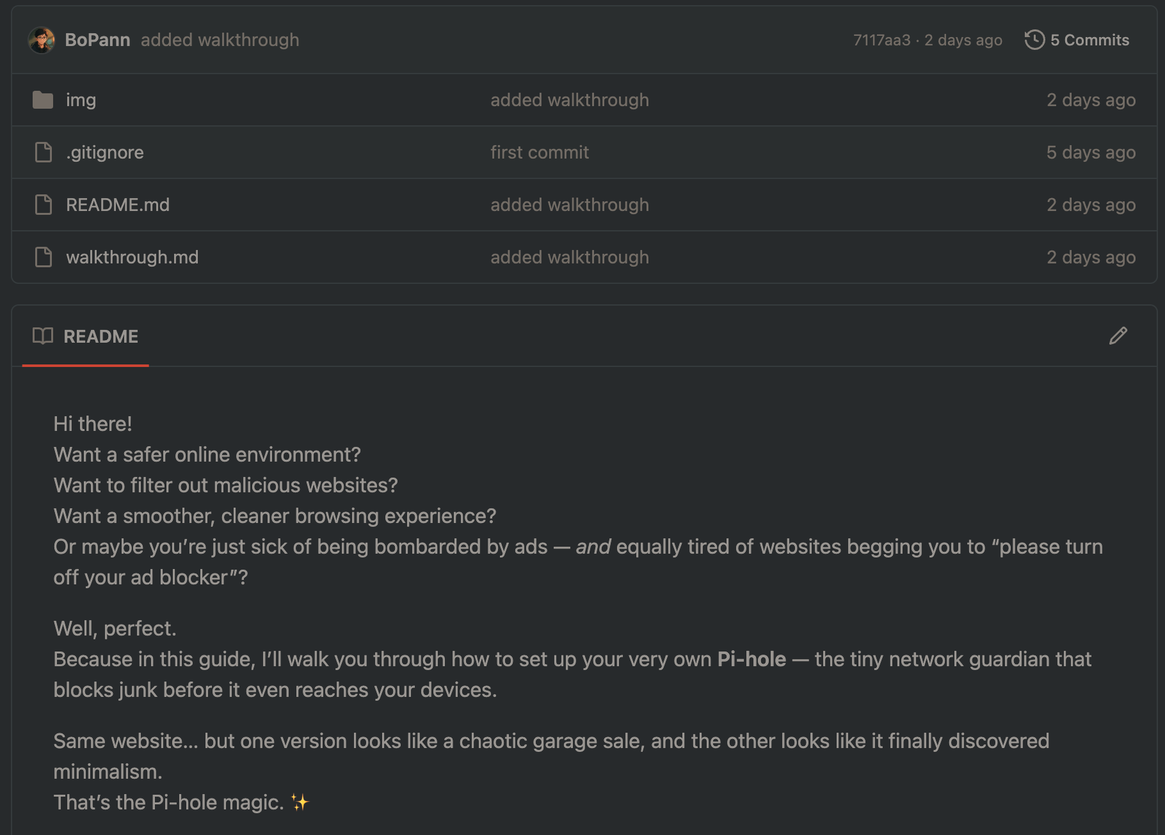
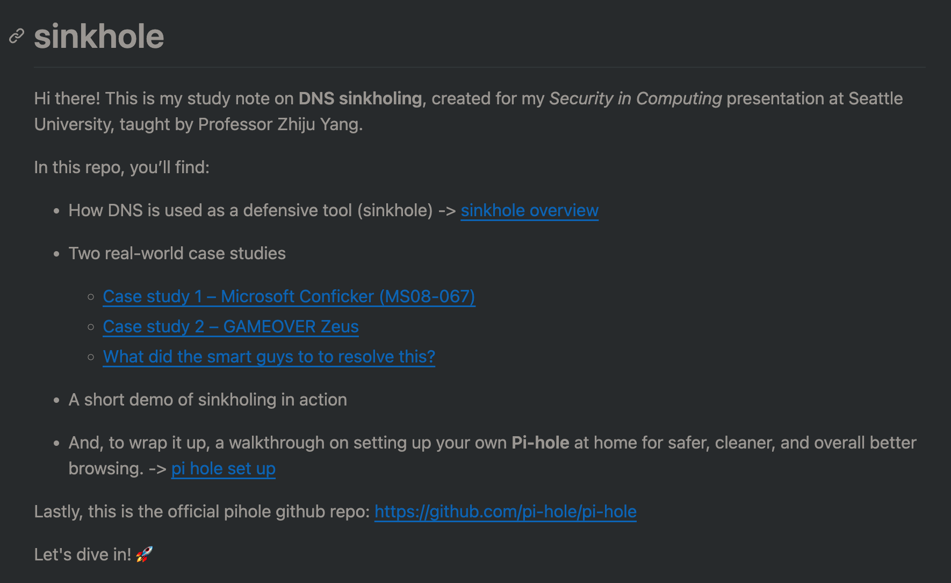
WRAP-UP

Slide 16
References
D. Piscitello, “Conficker Summary and Review,” ICANN, May 11, 2010. [Online]. Available: https://www.icann.org/en/system/files/files/conficker-summary-review-07may10-en.pdf
C. Rossow et al., "SoK: P2PWNED - Modeling and Evaluating the Resilience of Peer-to-Peer Botnets," 2013 IEEE Symposium on Security and Privacy, Berkeley, CA, USA, 2013, pp. 97-111, doi: 10.1109/SP.2013.17. [Online]. Available: https://ieeexplore-ieee-org.seattleu.idm.oclc.org/document/6547104/footnotes#footnotes-id-fn3
D. Andriesse, C. Rossow, B. Stone-Gross, D. Plohmann and H. Bos, "Highly resilient peer-to-peer botnets are here: An analysis of Gameover Zeus," 2013 8th International Conference on Malicious and Unwanted Software: "The Americas" (MALWARE), Fajardo, PR, USA, 2013, pp. 116-123, doi: 10.1109/MALWARE.2013.6703693. [Online]. Available: https://ieeexplore-ieee-org.seattleu.idm.oclc.org/document/6703693/references#references
Pi-hole Developers, “Pi-hole: A black hole for Internet advertisements,” GitHub repository, https://github.com/pi-hole/pi-hole (accessed Dec. 1, 2025).

Slide 17
THANK YOU!
Pi-hole set up tutorial:
https://github.com/BoPann

